Slide 1

The-challengers

Slide 2
Table of contents
Participant
Stage of realization
Apps/Language that we used
Block-scheme
Future ideas
Demonstration
Thank you for your attention

Slide 3
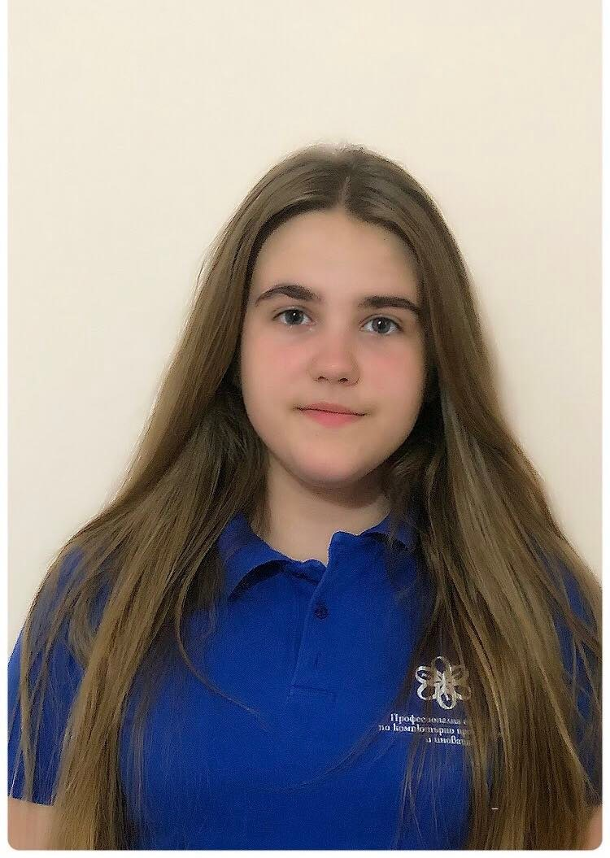
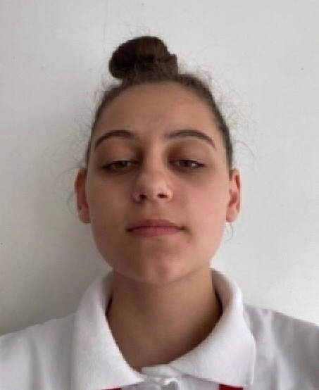
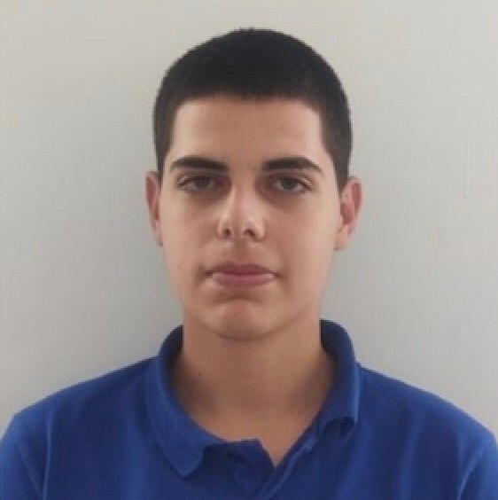
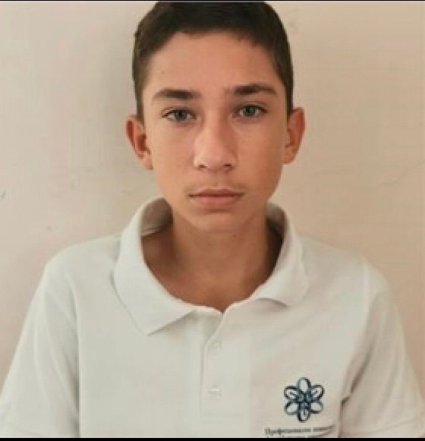
About our team
Kameliya Yaneva Xg
Scrum Trainer
Mirena Dzhebarova Xb
Front-End Developer
Ivan Staev Xv
Back-End Developer
Dimitar Berdankov Xa
QA Engineer

Slide 4
Stage of Realisation
Organisation
Realistaion
Presenting the final product

Slide 5







Apps/Language that we used

Slide 6
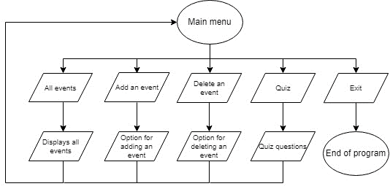
Block-scheme

Slide 7
Future ideas
Save events;
Search events;

Slide 8
Demonstration

Slide 9

Thank you for your attention!

